Slide 1

Algebra 1
Unit 7, Lesson 1 Factoring and the Distributive Property Volume 1, pg. 357

Slide 2


Benchmark
MA.912.AR.1.7
Rewrite a polynomial expression as a product of polynomials over the real number system.
volume 1, pg. 357

Slide 3
Integrated Mathematical Thinking and Reasoning Standards
MA.K12.MTR.3.1 Complete tasks with mathematical fluency.
MA.K12.MTR.4.1 Engage in discussions that reflect on the mathematical thinking of self and others.
volume 1, pg. 357

Slide 4

Learning Targets
I can rewrite a polynomial using the distributive property by factoring out a common factor.
I can determine the greatest common monomial factor.
volume 1, pg. 357

Slide 5

Warm-Up
volume 1, pg. 357

Slide 6
7.1.1 Warm-Up: Electric Motorcycle Engineer
Marc Fenigstein says, “Open-ended problems are the problems students will face in the real world … Forcing students to learn how to function in ambiguity and find their own answers … and that there isn’t necessarily any one right answer, but there might be better or worse answers … I think that is really valuable. Don’t be afraid to find your own path … You’re not going to get it right on the first try, but you can make almost any job your dream job by looking for opportunities to do more, to go beyond ...”
What stands out to you the most in this statement?
volume 1, pg. 357

Slide 7
Why does that part of the statement stand out to you?
volume 1, pg. 357

Slide 8

Exploration
volume 1, pg. 358

Slide 9

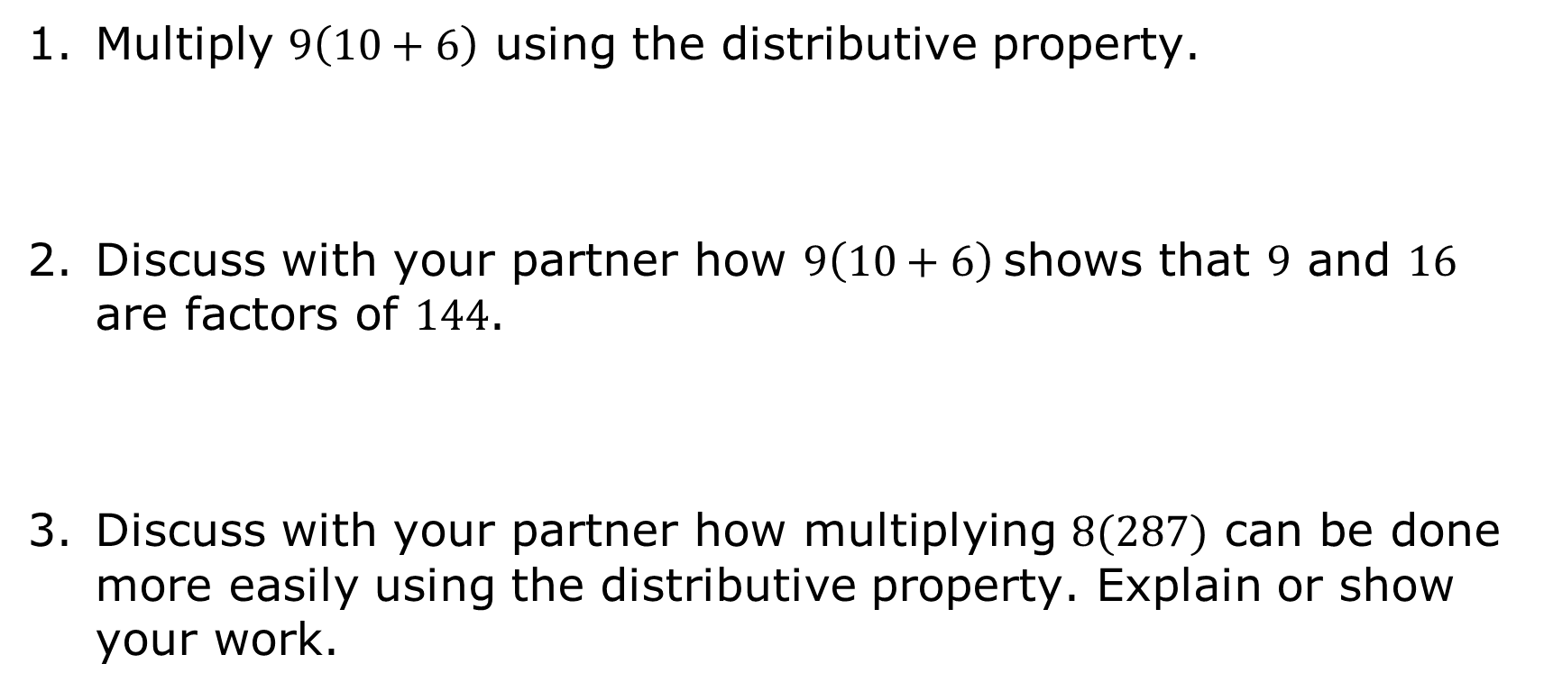
7.1.2 Exploration: The Distributive Property in Factoring
Multiply $9\left(10+6\right)$ using the distributive property.
Discuss with your partner how $9\left(10+6\right)$ shows that $9$ and $16$ are factors of $144$.
Discuss with your partner how multiplying $8(287)$ can be done more easily using the distributive property. Explain or show your work.
volume 1, pg. 358

Slide 10
Rewrite the expression $−7\left(2x−5\right)$using the distributive property.
volume 1, pg. 358

Slide 11
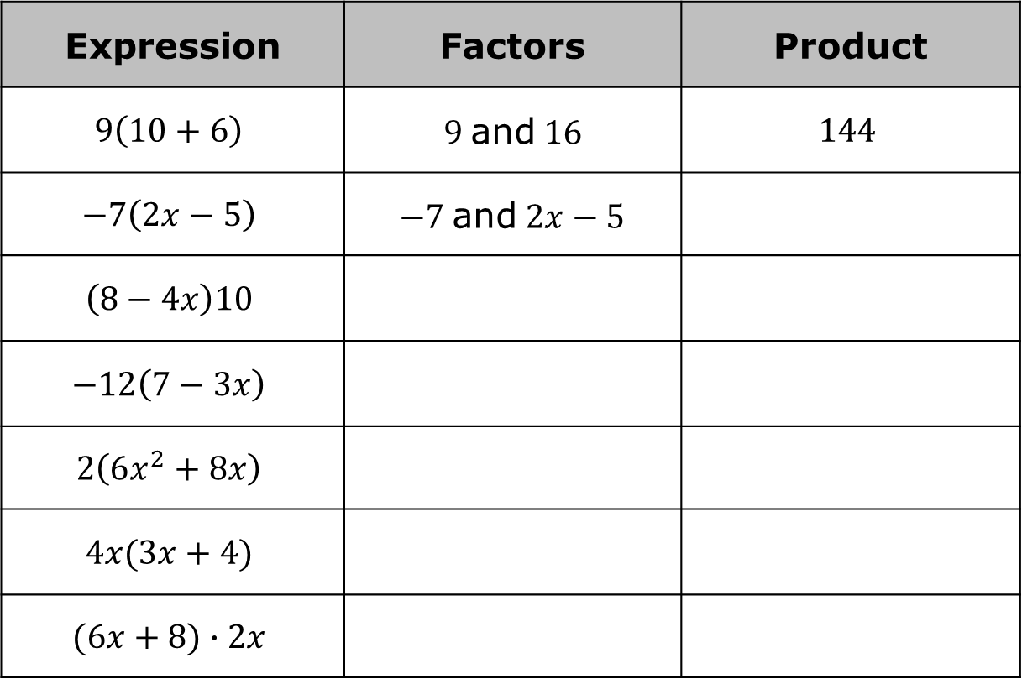
Complete the table.
Expression | Factors | Product
$$9\left(10+6\right)$$ | $9$ and $16$ | $$144$$
$$−7\left(2x−5\right)$$ | $−7$ and $2x−5$
$$\left(8−4x\right)10$$
$$−12\left(7−3x\right)$$
$$2\left(6x^{2}+8x\right)$$
$$4x(3x+4)$$
$$(6x+8)∙2x$$
volume 1, pg. 358

Slide 12
What do you notice about the product of each of the expressions $2\left(6x^{2}+8x\right)$, $4x(3x+4)$, and $(6x+8)∙2x$?
Expressions are equivalent if they have the same value no matter what number is substituted in for each of the variables.
volume 1, pg. 358

Slide 13
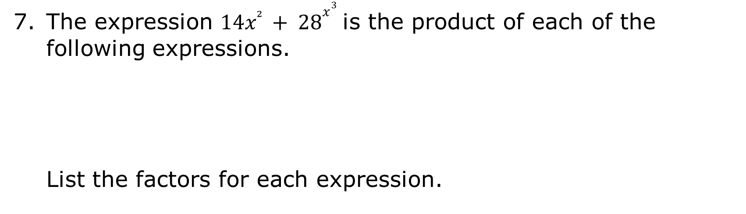
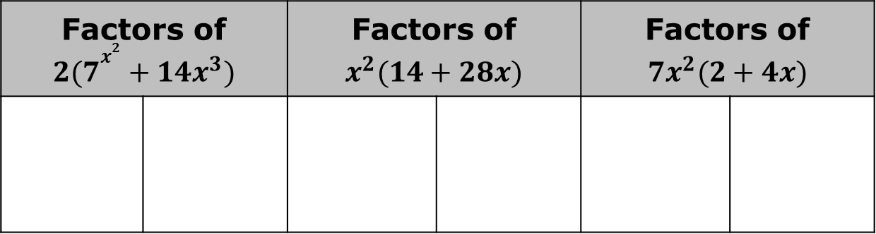
The expression $14x² + 28x^{3}$ is the product of each of the following expressions.
List the factors for each expression.
$$2(7x^{2}+14x^{3})$$ | $$x^{2}(14+28x)$$ | $$7x^{2}(2+4x)$$
Factors of $2(7x^{2}+14x^{3})$ |  | Factors of $x^{2}(14+28x)$ |  | Factors of $7x^{2}(2+4x)$
volume 1, pg. 359

Slide 14

Write two more expressions that are equivalent to $14x² + 28x^{3}$.
Compare your expressions with your partner’s expression. Write the expressions that you and your partner do not have in common.
volume 1, pg. 359

Slide 15
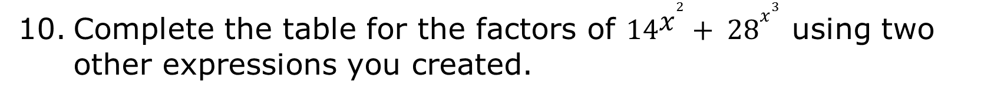
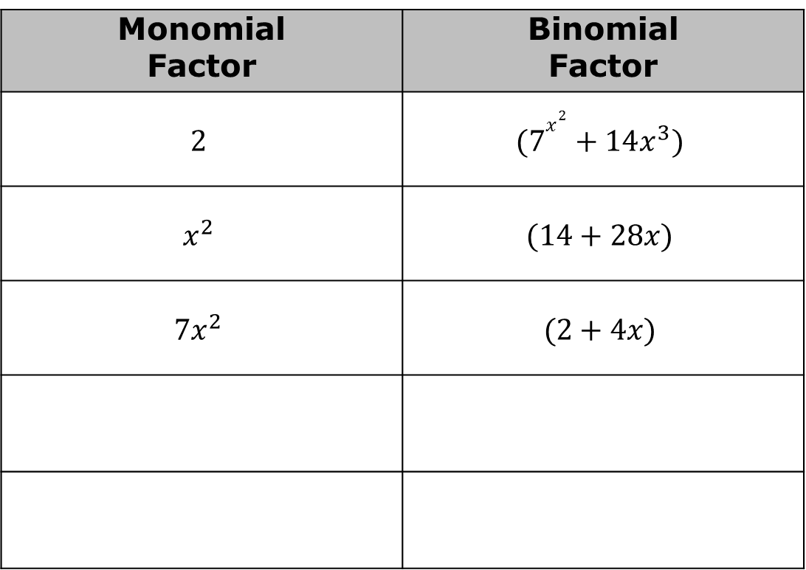
Complete the table for the factors of $14x^{2}+ 28x^{3}$ using two other expressions you created.
Monomial Factor | Binomial Factor
$$2$$ | $$(7x^{2}+14x^{3})$$
$$x^{2}$$ | $$(14+28x)$$
$$7x^{2}$$ | $$(2+4x)$$
volume 1, pg. 359

Slide 16

Guided Instruction
volume 1, pg. 360

Slide 17
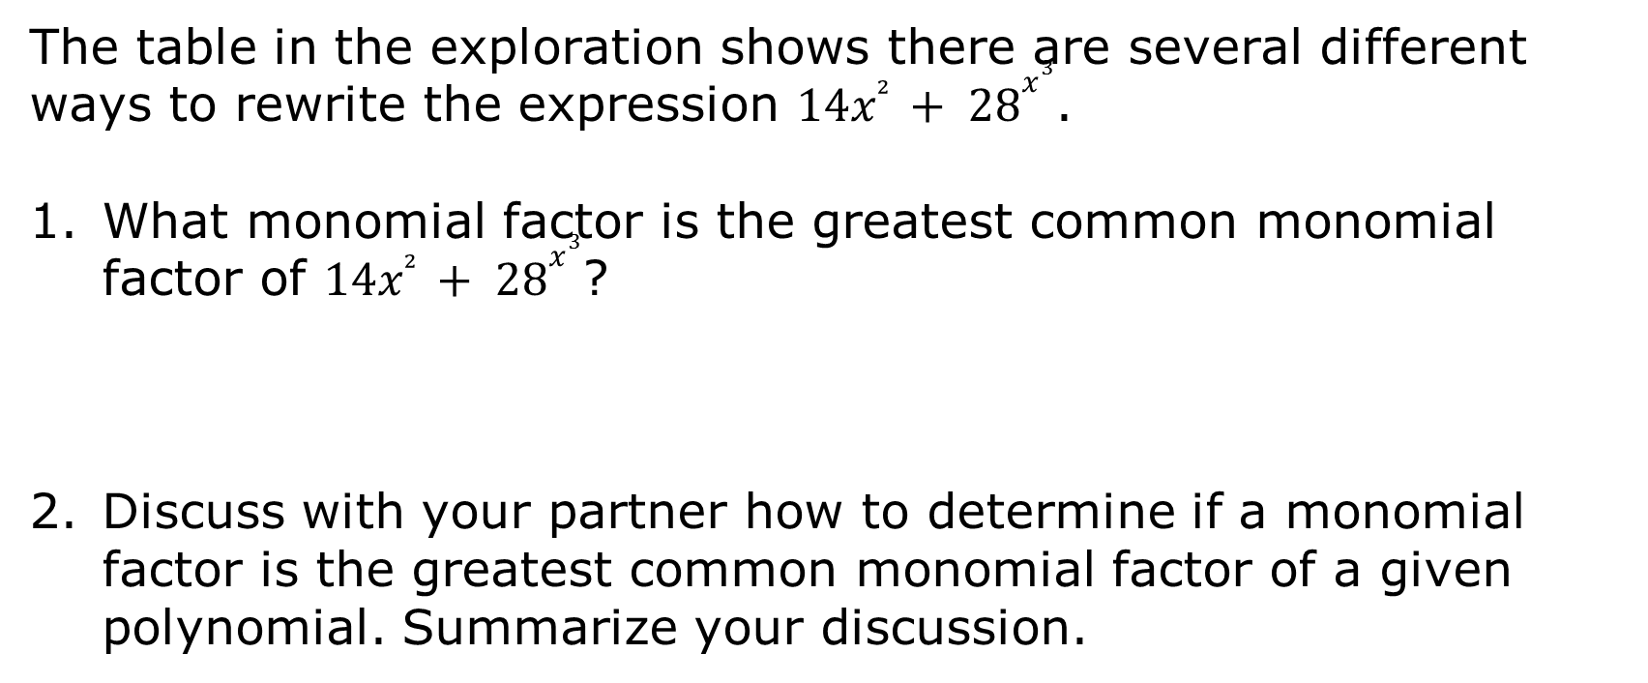
7.1.3 Guided Instruction: Common Monomial Factors
The table in the exploration shows there are several different ways to rewrite the expression $14x² + 28x^{3}$.
What monomial factor is the greatest common monomial factor of $14x² + 28x^{3}$?
Discuss with your partner how to determine if a monomial factor is the greatest common monomial factor of a given polynomial. Summarize your discussion.
volume 1, pg. 360

Slide 18

Determine the greatest common factor for $24, −36,$ and $−54$.
Determine the greatest common factor for $x^{7}$, $x^{10}$, and $x^{13}.$
volume 1, pg. 360

Slide 19
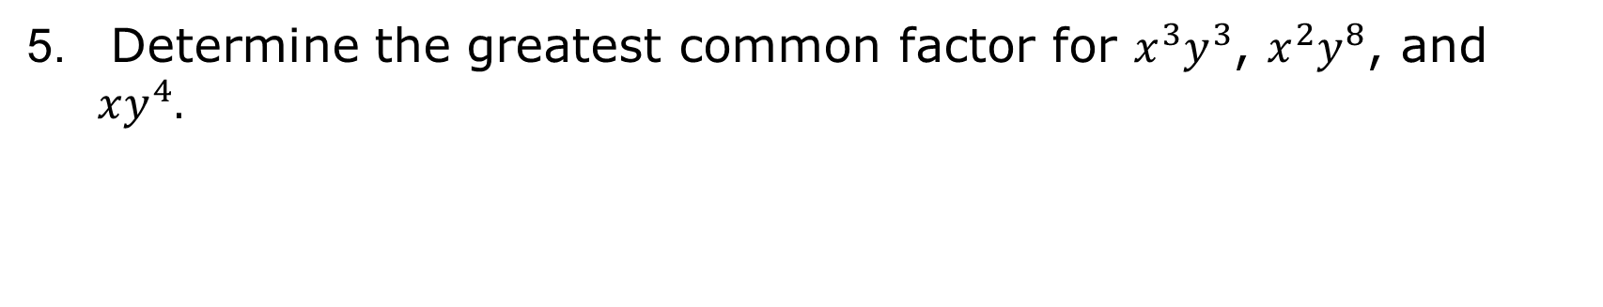
Determine the greatest common factor for $x^{3}y^{3}$, $x^{2}y^{8}$, and $xy^{4}.$
volume 1, pg. 360

Slide 20
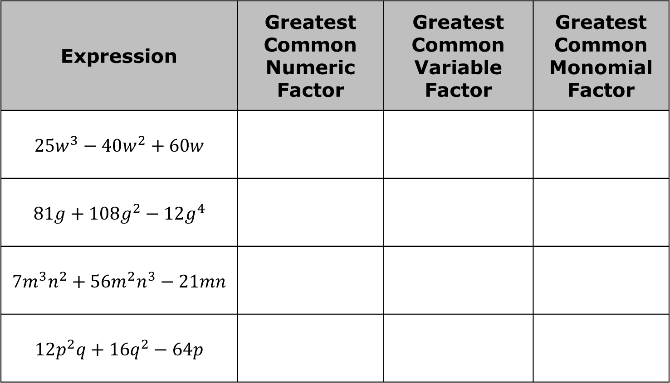
Work with your partner to complete the table. If an expression does not have one of the greatest common factors listed, write N/A.
Expression | Greatest Common Numeric Factor | Greatest Common Variable Factor | Greatest Common Monomial Factor
$$25w^{3}−40w^{2}+60w$$
$$81g+108g^{2}−12g^{4}$$
$$7m^{3}n^{2}+56m^{2}n^{3}−21mn$$
$$12p^{2}q+16q^{2}−64p$$
volume 1, pg. 360

Slide 21

Guided Practice
volume 1, pg. 361

Slide 22

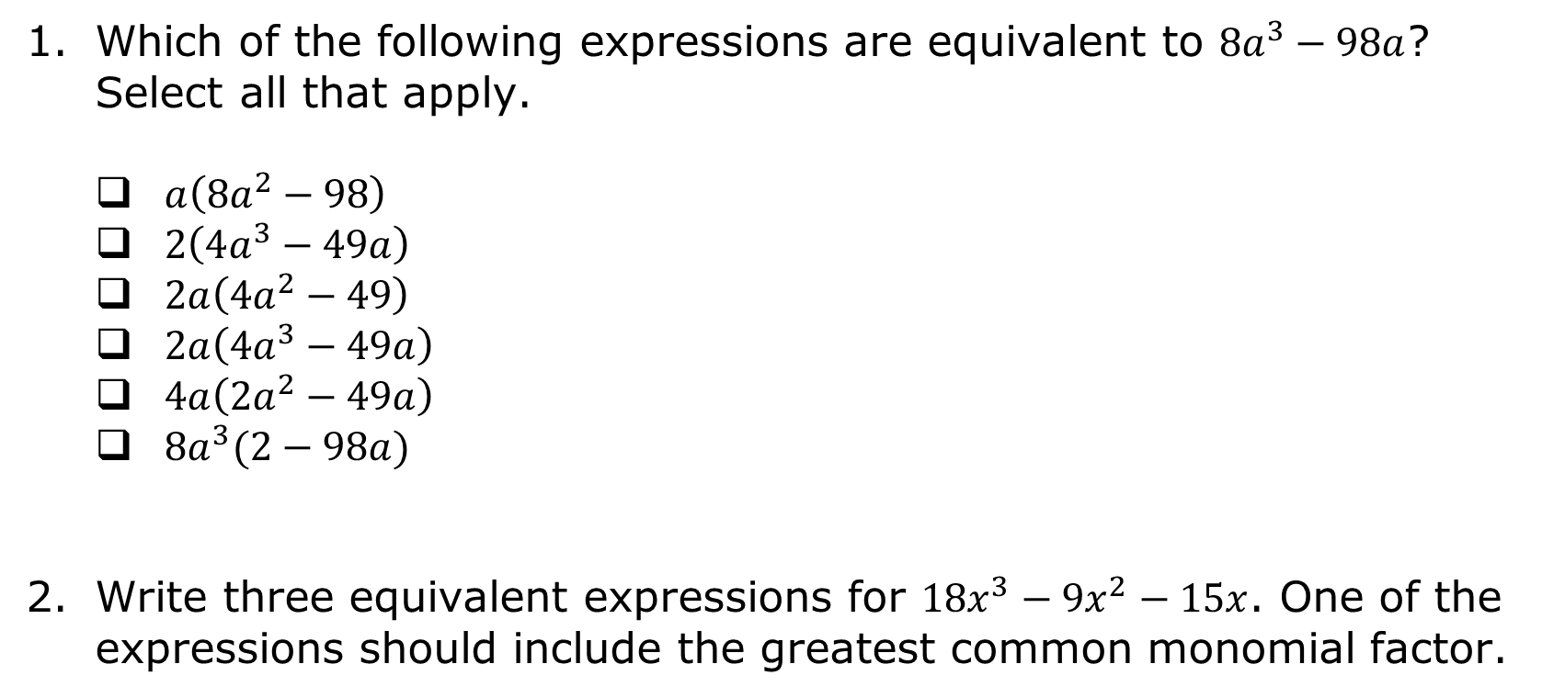
7.1.4 Guided Practice: Factoring With the Distributive Property
Which of the following expressions are equivalent to $8a^{3}−98a$? Select all that apply.
$a\left(8a^{2}−98\right)$
$2\left(4a^{3}−49a\right)$
$2a\left(4a^{2}−49\right)$
$2a\left(4a^{3}−49a\right)$
$4a\left(2a^{2}−49a\right)$
$8a^{3}(2−98a)$
Write three equivalent expressions for $18x^{3}−9x^{2}−15x$. One of the expressions should include the greatest common monomial factor.
volume 1, pg. 361

Slide 23
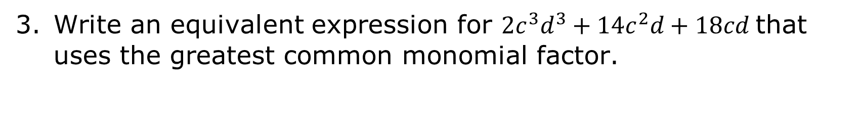
Write an equivalent expression for ${2c}^{3}d^{3}+14c^{2}d+18cd$ that uses the greatest common monomial factor.
volume 1, pg. 361

Slide 24

Your Turn
volume 1, pg. 361

Slide 25
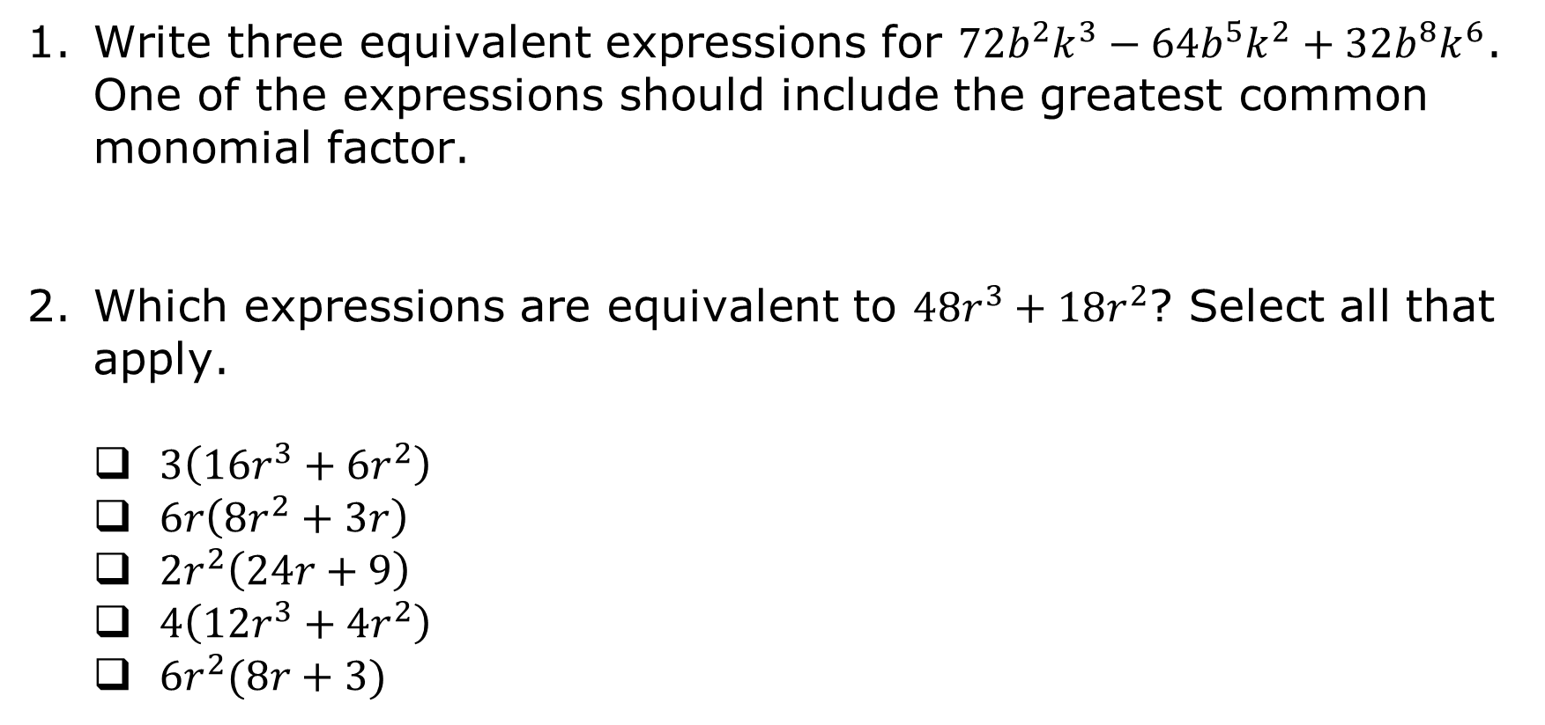
7.1.5 Your Turn!
Write three equivalent expressions for $72b^{2}k^{3}−64b^{5}k^{2}+32b^{8}k^{6}$. One of the expressions should include the greatest common monomial factor.
Which expressions are equivalent to $48r^{3}+18r^{2}$? Select all that apply.
$3\left(16r^{3}+6r^{2}\right)$
$6r\left(8r^{2}+3r\right)$
$2r^{2}\left(24r+9\right)$
$4\left(12r^{3}+4r^{2}\right)$
$6r^{2}(8r+3)$
volume 1, pg. 361

Slide 26

Wrap-Up
volume 1, pg. 362

Slide 27
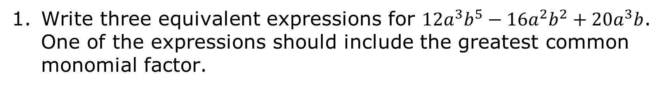
7.1.6 Wrap-Up: Ticket Out the Door
Write three equivalent expressions for $12a^{3}b^{5}−16a^{2}b^{2}+20a^{3}b$. One of the expressions should include the greatest common monomial factor.
volume 1, pg. 362

